Slide 1



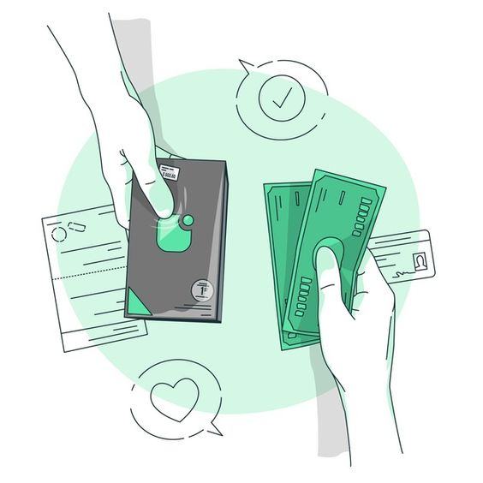
THIQA: AI-Powered Receipt and Warranty Management System
By Hussain, Ali and Haitham
Supervised by Dr. Ahmed Fahad & Dr. Amal Shaheen
1

Slide 2




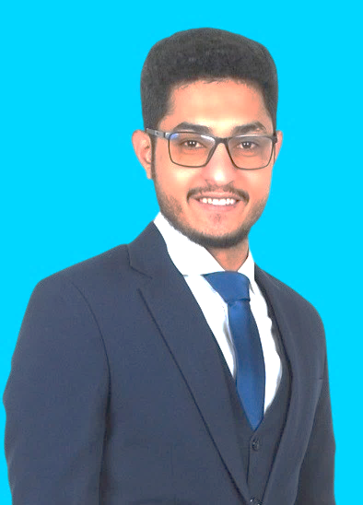



FOUNDING TEAM
Hussain Nooh
Co-Founder & Head of QA
Founders Team
Introducing our Leadership Team
Haitham Monia
Co-Founder & Head of Operations
Ali Abass
Co-Founder & Head of Development
2

Slide 3











Take a think!
Do you have active warranties? Where are they?
Have you missed a warranty claim?
Do you know how much you spent this week on food only?
3

Slide 4










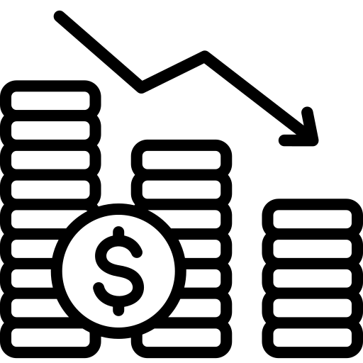
Problems of
Traditional Receipts & Warranties
Based on research studies
Numerous paper waste
Difficulty to find Receipts and Warranties
Retailers in the United States alone produce millions of pounds of receipt paper each year, a large percentage of which turns straight waste
Receipts and warranties are scattered in different places making it hard to manage them.
Millon's of dollars potentially lost
Consumers often miss warranty claim opportunities losing product values, while retailers lose from managing receipts and warranties operations.
Untracked and lost data
Receipts hold useful data, but without tracking or analysis, the insights remain buried.
4

Slide 5



Problem
Statement
Receipts are still mostly issued in paper form, which are subjected to loss or damage.
Existing tools lack intelligence, are fragmented, or business-focused.
No standard method exists to verify product ownership or warranty status reliably.
5

Slide 6
200 Members survey
7

Slide 7
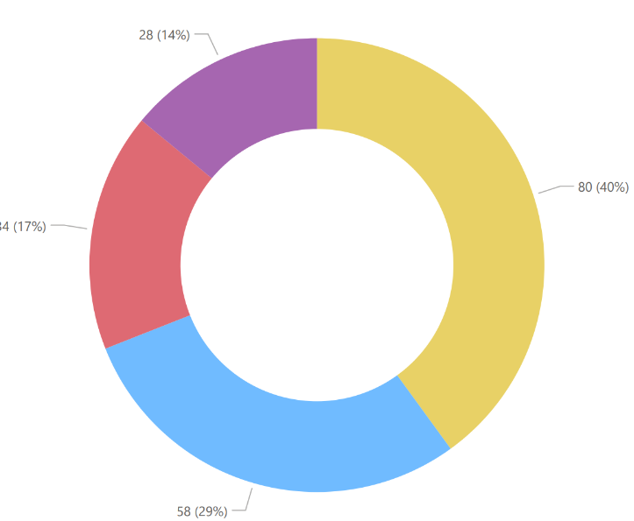
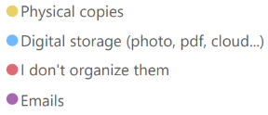
Survey Questions 200 participant
How do you store & manage receipts and warranties?
8

Slide 8
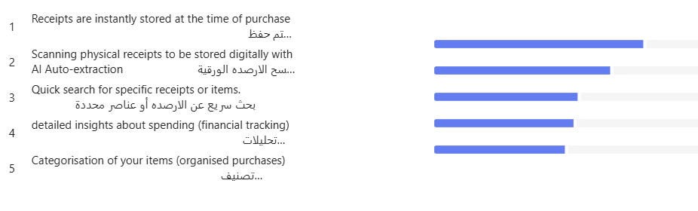
Survey Questions 200 participant
Rank the features of a receipt system that would be most valuable to you:
9

Slide 9
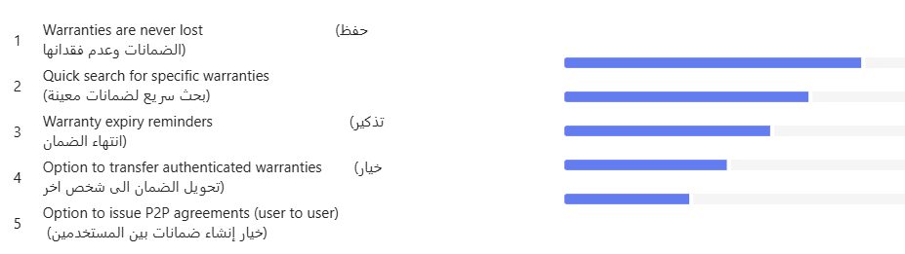
Survey Questions 200 participant
Rank the features of a warranty system that would be MOST valuable to you:
10

Slide 10

THIQA
THE ULTIMATE SOLTUION
6

Slide 11






Our Objective
Introduction Of Thiqa
The ultimate solution
Mobile Application
AI-POWERED OCR
01
Develop a centralized mobile platform to organize and secure receipts and warranty documents.
04
High-accuracy AI-OCR with Arabic and handwriting support to transform paper receipts into the application
Real time digital receipts & warranties
Intelligent expense analysis
02
Enable real-time, automated receipt generation and integration at the point of sale (POS).
05
Extract and analyze meaning full data from user receipts using AI categorizations.
Digital transformation
Authenticated P2P Agreements
03
Achieve digital transformation by storing receipts and warranties digitally, enabling advanced operations like transferring warranties and easy accesses.
06
Securely store warranties as authenticated p2p agreements as a verifiable proof ensuring trust between users.
11

Slide 12














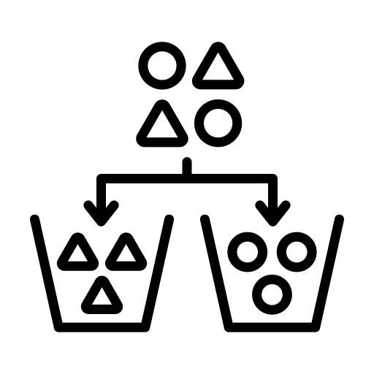


Our implemented functionalities
Thiqa Features
Brining hands on experiences
Set reminders in calendar
Transfer Warranty
Dark/Light Theme
Scan Document
Search for Documents
Real Time notifications
Claim/Renew Warranty
View Spendings insights
Issue P2P agreement
Filter & sort
Fraud detection
Intelligent Categorization
Real Time Document Storing
Procces Claim
Top Users & Rewards
13

Slide 13
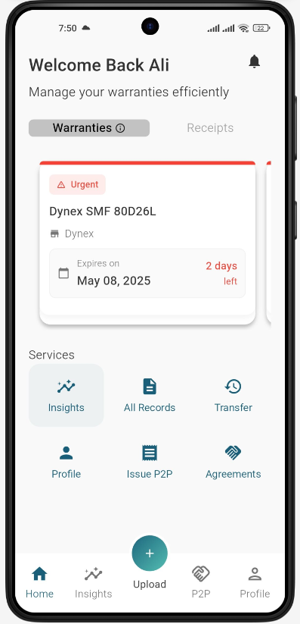
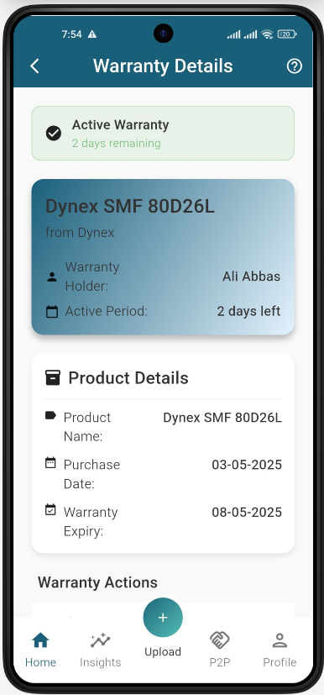
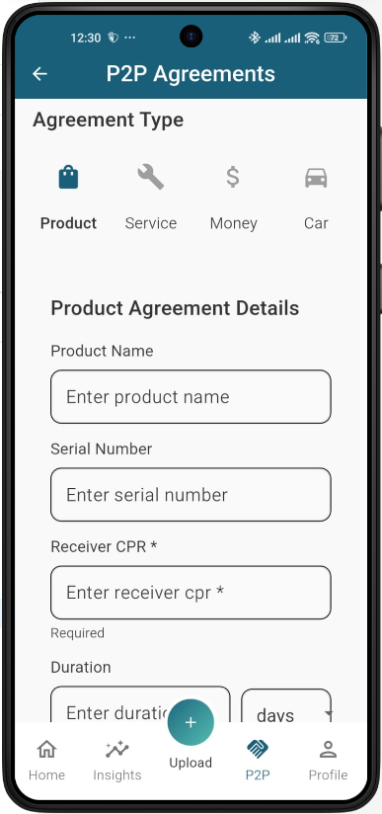
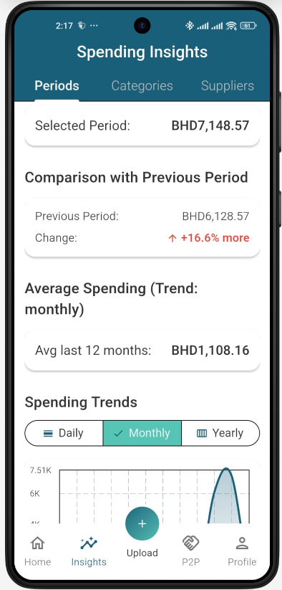
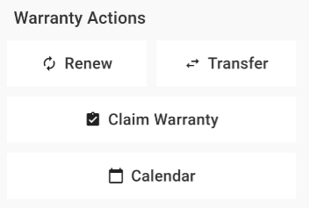
12

Slide 14
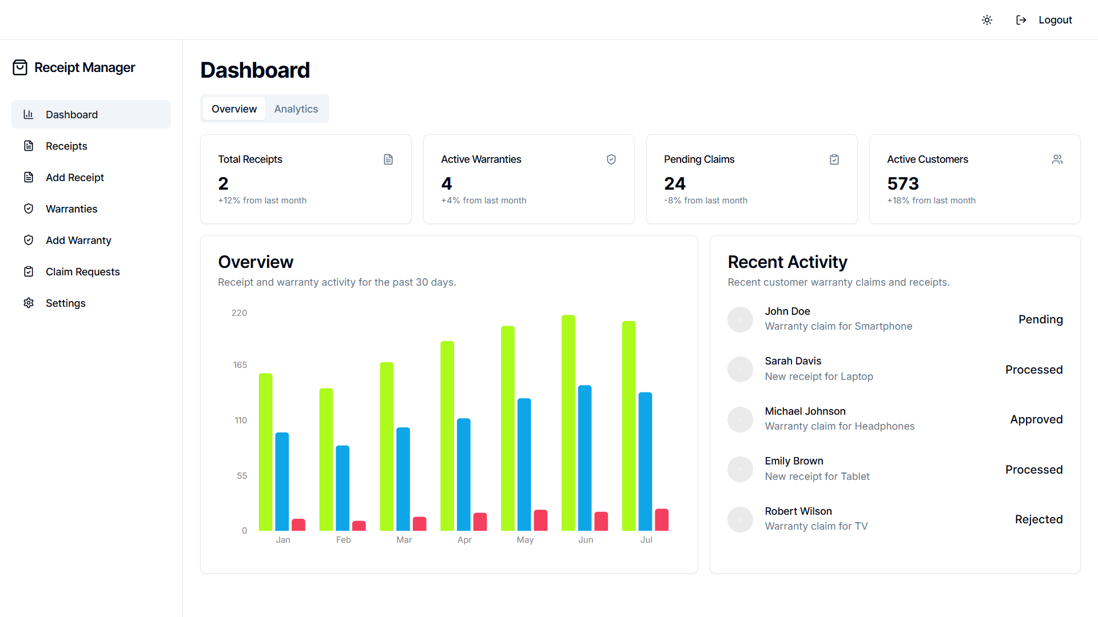
Retailer demo dashboard
15

Slide 15






Thiqa
System Architecture
The main components
Notifications
Authentication
Data Storage
Handled by Firebase Authentication for secure login and session management.
Firestore stores user profiles, warranties, and metadata (real-time, scalable).
Cloud Storage stores receipts and warranty documents (images, PDFs).
Firebase Cloud Messaging (FCM) enables reliable and efficient push notifications across Android, iOS, and web platforms.
Frontend
AI Integration
Flutter-based mobile app (iOS & Android) handles user interaction and connects to backend via APIs.
Business Logic
Uses Google Document AI to extract data from uploaded receipts and Gemini for classification.
Firebase Functions respond to events (e.g., file uploads, HTTP requests) with auto-scaling and cost efficiency, built in a serverless architecture.

Slide 16
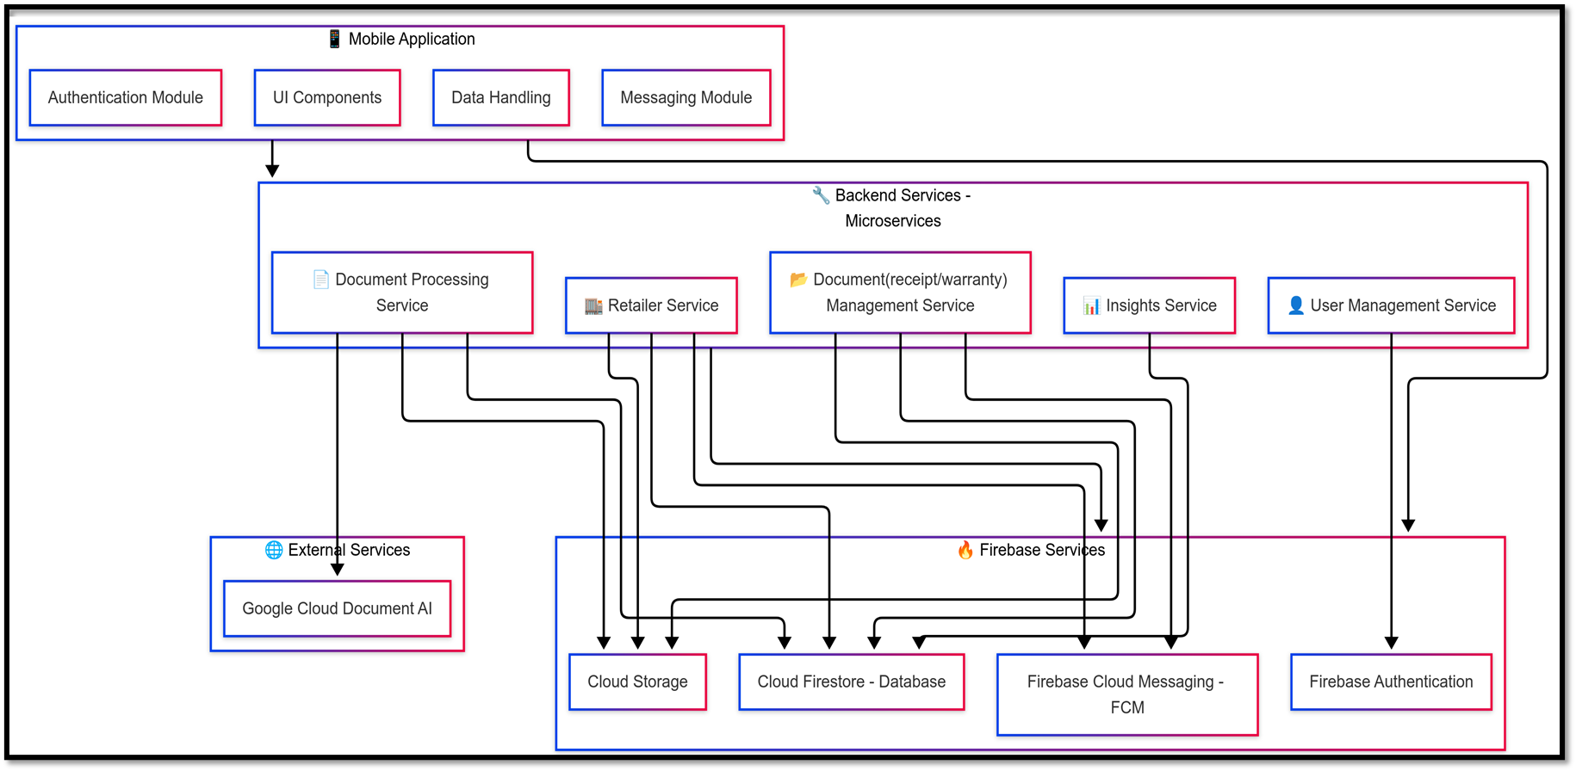
System Package Diagram
14

Slide 17


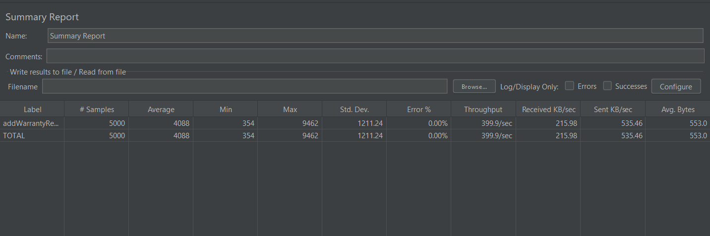
System Testing
Tests Performed
01
02
03
04
05
Integration Testing
Unit Testing
System Testing
Acceptance Testing
Stress and Load Testing
16

Slide 18
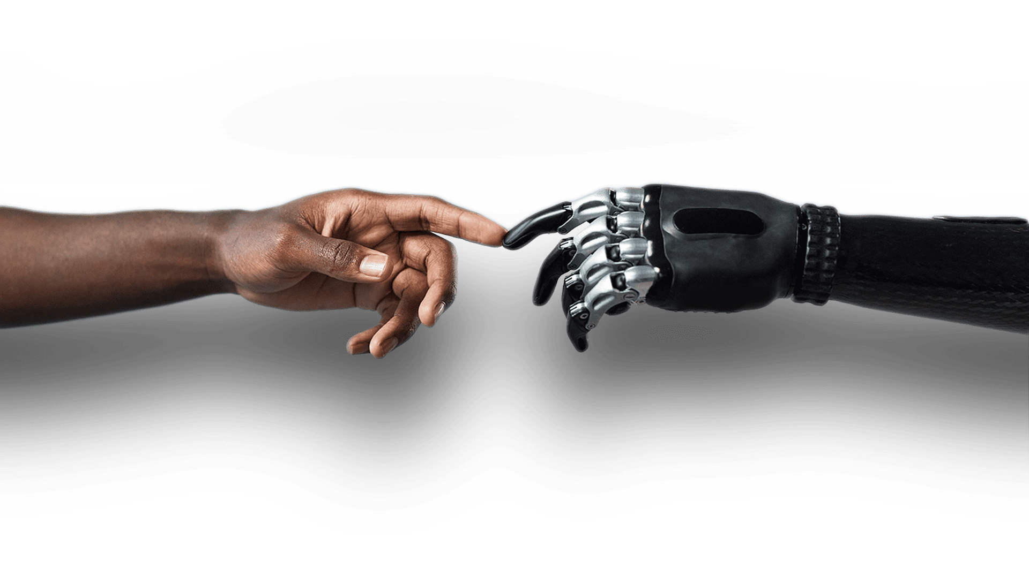








The future of Thiqa
Future Work
Unleashing AI’s potential
AI Assistant
Spending Advisor
Demand Prediction
Insurance Integration
Allow user to interact with an AI agent using natural language that answers questions, provides conversational insights, and delivers smart reports for informed decision-making.
Spending Advisor uses AI to analyze user spending behavior and suggests potential savings by identifying spending patterns and optimization opportunities.
Demand Prediction analyzes user purchases to provide retailers with trending demand scores for products, helping them optimize stock and sales strategies.
Insurance Integration allows seamless storage of various insurance types, such as car and life insurance, directly within our system for easy management.
17

Slide 19


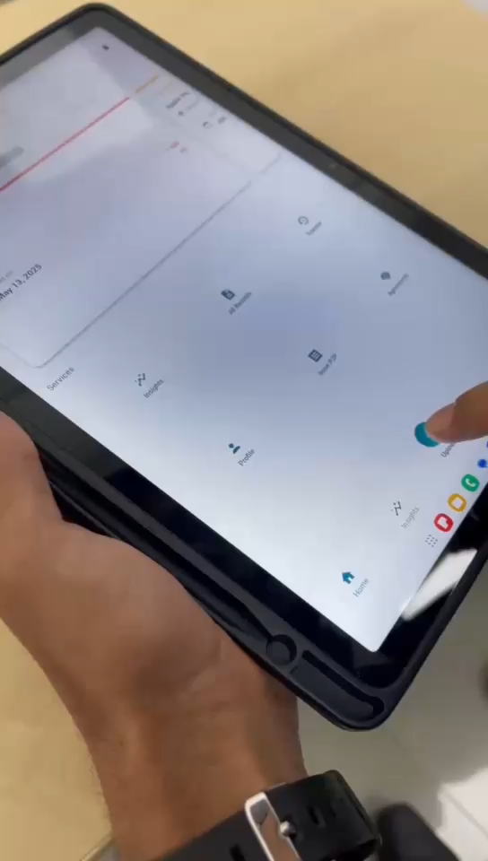

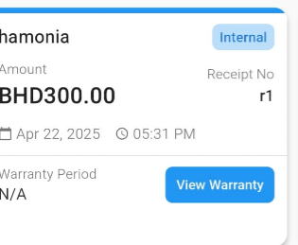
Thank You For Listening!
Feel Free to Ask!
Join us to discover how Thiqa can elevate your receipts and warranties. Don't miss out on this opportunity!
18

